Slide 1
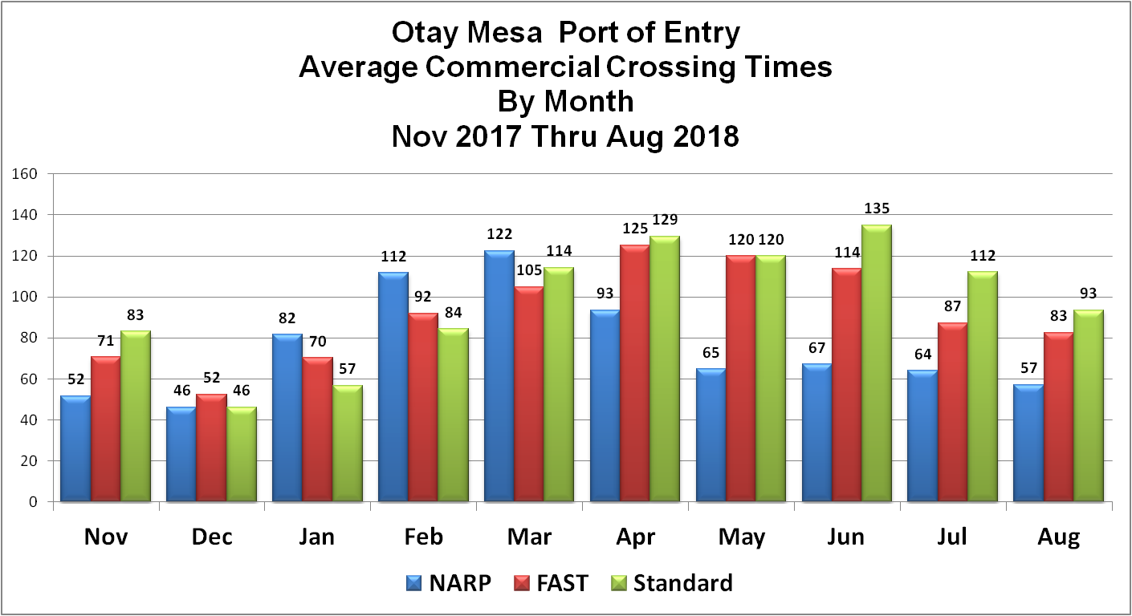
Otay Mesa Port of Entry: Average Commercial Crossing Times By Month Nov 2017 thru Aug 2018
Month | NARP | FAST | Standard
Nov | 52 | 71 | 83
Dec | 46 | 52 | 46
Jan | 82 | 70 | 57
Feb | 112 | 92 | 84
Mar | 122 | 105 | 114
Apr | 93 | 125 | 129
May | 65 | 120 | 120
Jun | 67 | 114 | 135
Jul | 64 | 87 | 112
Aug | 57 | 83 | 93

Slide 2
Segmented Crossing Times by Shipment Type
Shipmen Type | SAT Wait Time | SAT Exit | SAT Insp. | CBP Wait Time | CBP Insp. | CHP Insp. | Port Exit | Average Total
NARP | 23 | 19 | 0 | 8 | 10 | 2 | 13 | 75
FAST | 45 | 12 | 3 | 9 | 8 | 2 | 12 | 92
Standard | 54 | 14 | 6 | 11 | 4 | 2 | 11 | 102
Otay Mesa
Sample Cross Border Shipment

Slide 3
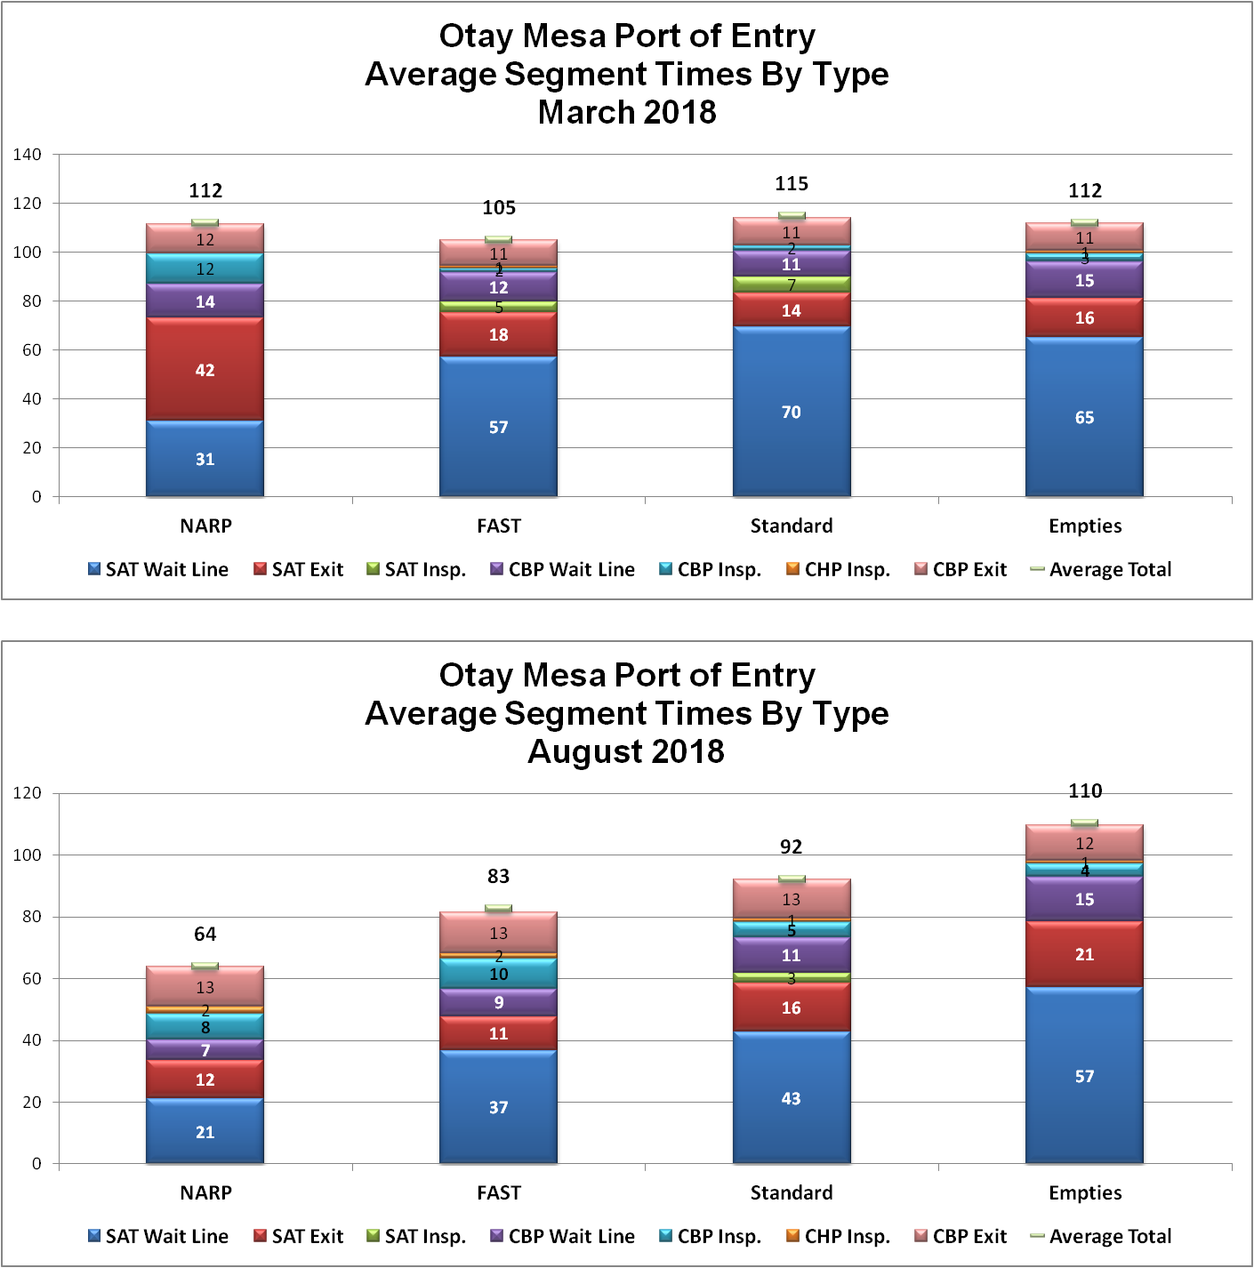

Slide 4
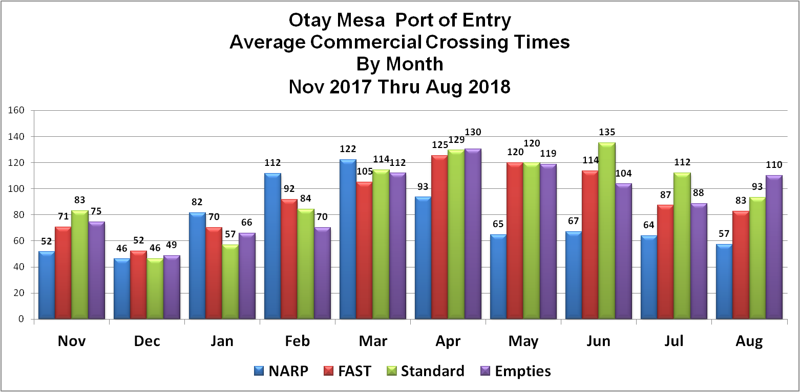

Slide 5
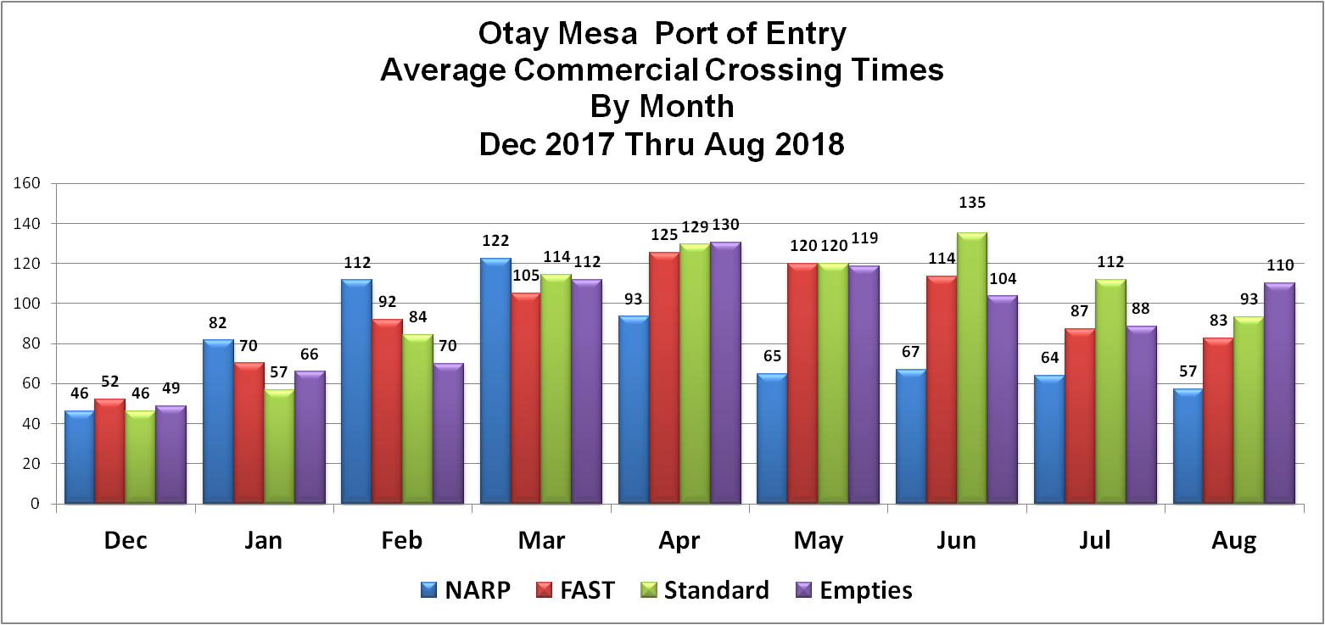

Slide 6
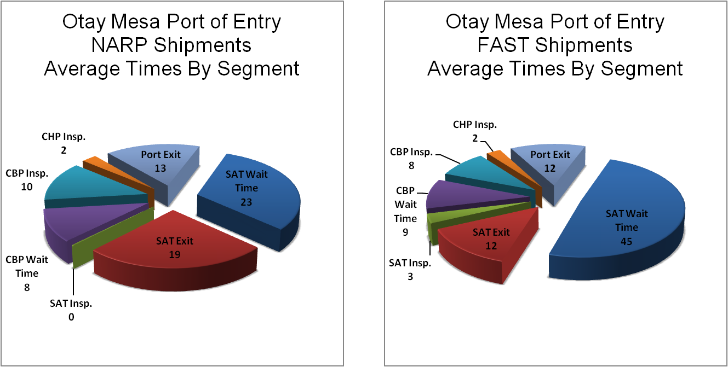
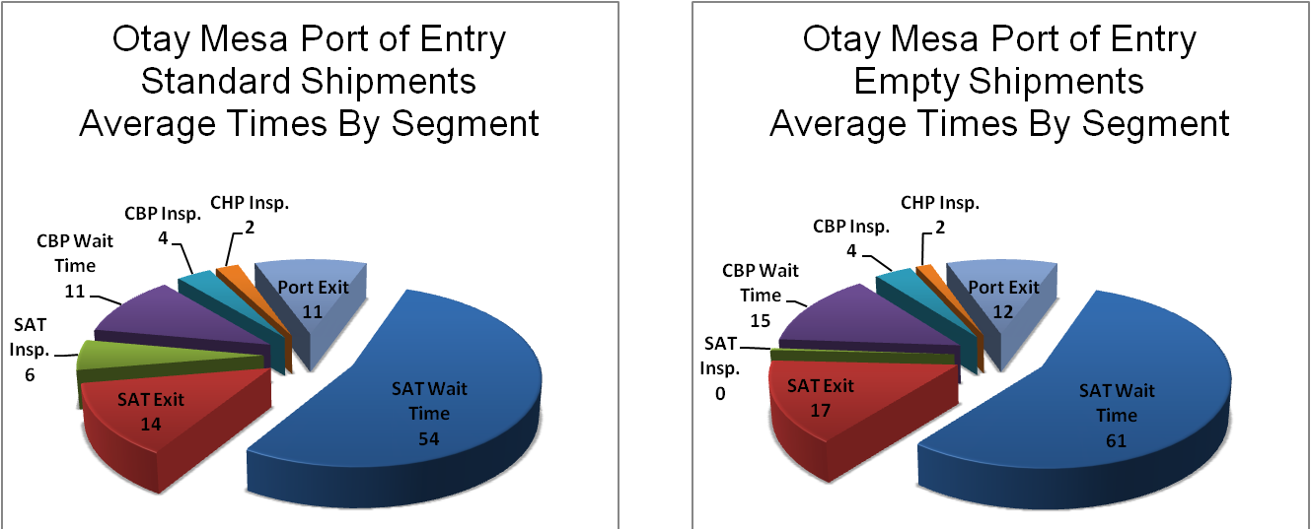

Slide 7
Some Conclusions
FAST wait times have been decreasing substantially since April (125 minutes vs 83)
However, the difference with Standard cargo is not much less (FAST average times were actually more than Standard times in April and were 10 minutes less in August).
NARP wait times are less than half what they were in March.
Empty truck wait times increased by more than 70% in April when compared with November. In August they were the third highest in the last 10 months.
In all cases, it is SAT wait time segment (line before arriving at the first SAT booth) that represents the greatest time, followed by SAT exit segment.
Source: Secure Origins. Inc. 2 cross border shipments per truck per day, 80 trucks total. Same number Northbound and Southbound.

